Slide 1
Mantid Scientific Steering Committee
Pre-meeting

Slide 2
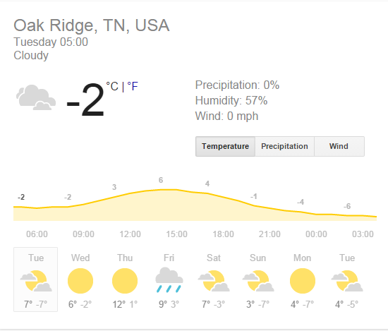
Weather

Slide 3
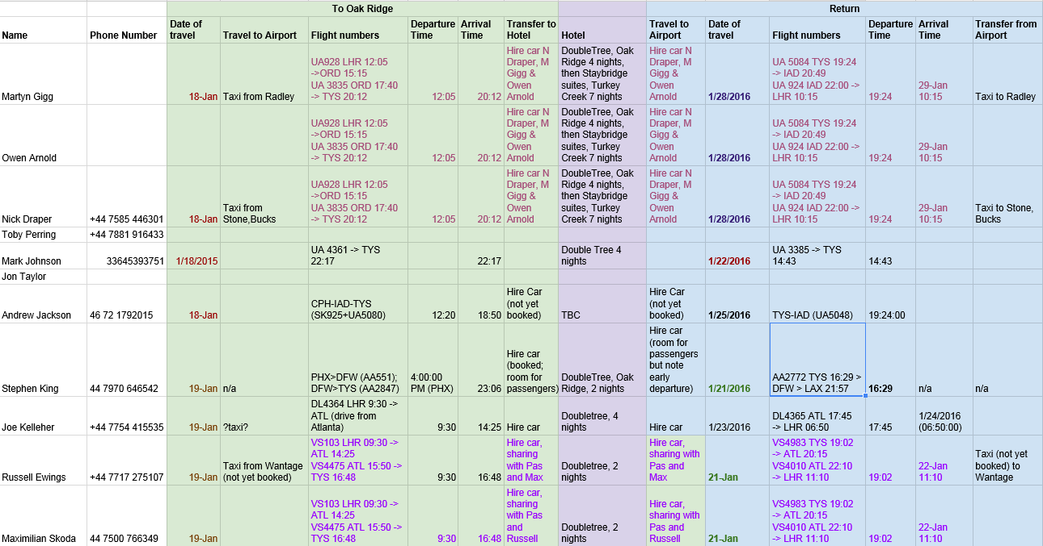
Travel arrangements
https://docs.google.com/spreadsheet/ccc?key=0Aq36k77Hr7BldGg0Tnh1bjFKdXhBR09QTHlxWGE4a0E&usp=sharing

Slide 4
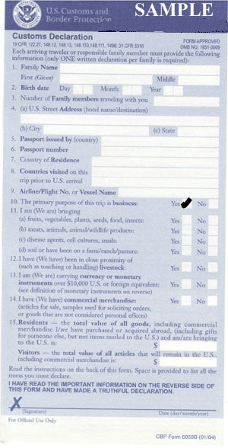
Immigration
On the customs form AND at the immigration booth state the purpose of your visit as business
Otherwise you will not be allowed on site at ORNL

Slide 5
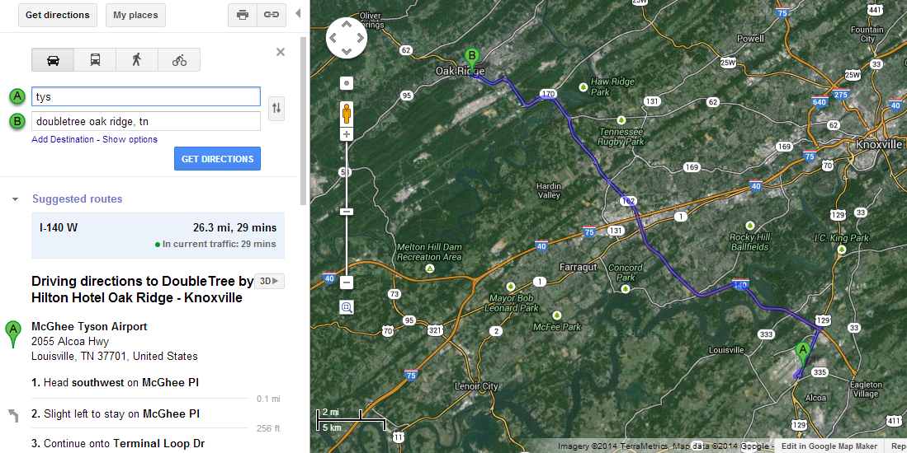
Route to the Hotel

Slide 6
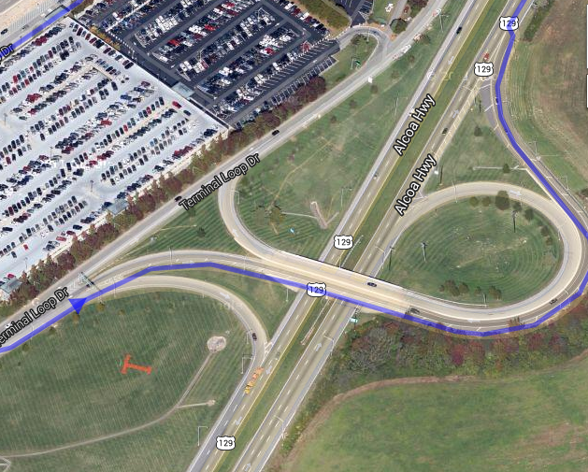
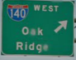
Simplified directions
On leaving the Airport keep go over the bridge to TN-115 N/ US-129N
After 2.6m merge onto I-140 W to Oak Ridge
Follow the road and signs to Oak Ridge
On entering Oak Ridge the hotel is on your right after several traffic lights.

Slide 7
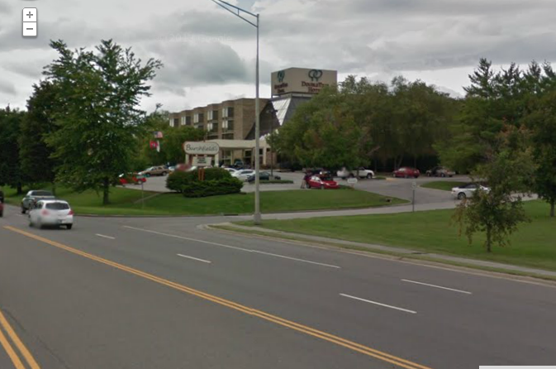
The Hotel seen from the road
215 S. Illinois Avenue, Oak Ridge, Tennessee, 37830, USATEL: 1-865-481-2468FAX: 1-865-481-2474

Slide 8
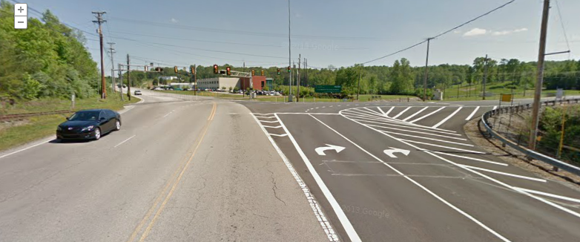
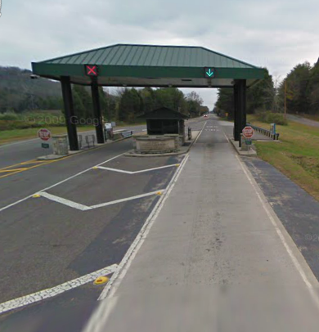
Getting into ORNL
8:45am Meet in Hotel Lobby (With Passports) Split into cars and drive to ORNL Do NOT drive into Y-12
9:00 Use the right lane at the gatehouse
Then drive to visitor centre to collect passes Then drive to the SNS

Slide 9
Meeting attendees and agenda
http://www.mantidproject.org/Scientific_Steering_Committee_2016

Slide 10
Other information
Meeting Host: Garrett Granroth 865-805-0631
Nick’s Phone number: +44 7585 446301

Slide 11

Any Questions

